Slide 1

SMART BLIND STICK
CSM-601
TE MINI PROJECT 2B
By: Abhiyash Bait, Sunit Chavhan, Aniruddha Dabade, Siddhesh Haryan
Group No: 37
Project Guide: Prof Antra Pal

Slide 2
INTRODUCTION
The Smart Blind Man's Stick using ultrasonic sensors represents a groundbreaking innovation in assistive technology, seeking to enhance the autonomy and safety of visually impaired individuals.
By integrating ultrasonic sensors into the traditional white cane, this intelligent device employs cutting-edge technology to detect obstacles in real-time.
The ultrasonic sensors emit high-frequency waves, measuring the distance to nearby objects and providing instant feedback to the user.

Slide 3
LITERATURE REVIEW
No. | Title | Author | Research Focus
1 | Exploring the design of assistive technologies for distance social touch. In Proceedings of the 12th ACM international conference on Ubiquitous computing (UbiComp) | Zhao, S., Shi, Y., & Forlizzi, J. (2010) | Human-Computer Interaction, Ubiquitous Computing, and Assistive Technologies.
2 | A foundation for usability. Universal Access in the Information Society | Hanson, V. L., & Richards, J. T. (2015) | Accessibility, Inclusive Design, Human-Computer Interaction.

Slide 4
KEY FEATURES
Functionality: Utilizes ultrasonic waves to detect obstacles and provide real-time feedback to the user.
Navigation Aid: Aims to improve navigation through various environments, including indoor and outdoor spaces.
Integration with Smart Devices: Potential connectivity with smartphones or other devices for additional features, such as GPS navigation or remote monitoring.

Slide 5
PROPOSED SYSTEM
Our system has ultrasonic sensor to detect obstacles and send feedback to the user by auditory signals.
Navigation system helps in directing the user in the right directions.
With the help of GPS module we can track real time location of the user.
Emergency button is provided to share real time location with others.

Slide 6
Hardware components
Arduino Nano
Ultrasonic Sensor HC-SR04
LDR
Buzzer and LED
7805 IC
Resistors
Capacitors
Push button
Perf board
Soldering Kit
9V batteries
SD card holder and earphones

Slide 7
SOFTWARE REQUIREMENTS
Embedded Software for Microcontroller:
Development environment for programming the microcontroller (e.g., Arduino IDE, PlatformIO).
Firmware development tools specific to the microcontroller used in the stick.
Programming Languages:
C/C++ for microcontroller programming.
If the device involves app development for connectivity, knowledge of programming languages such as Java (for Android) or Swift (for iOS) may be necessary.
Testing Tools:
Debugging tools for microcontroller programming (e.g., GDB for debugging).
Testing frameworks for software validation.

Slide 8
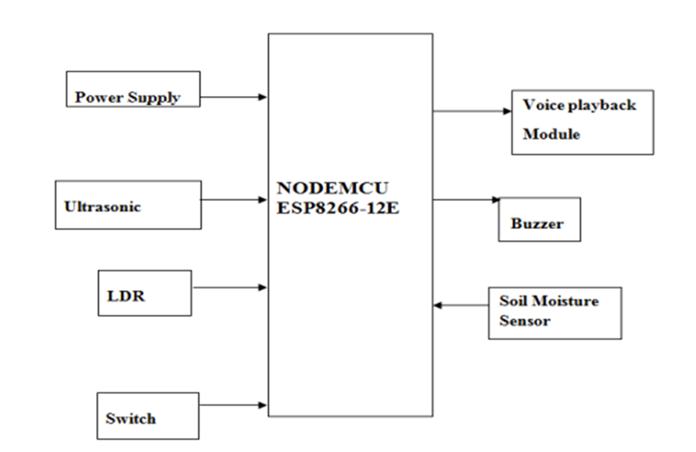
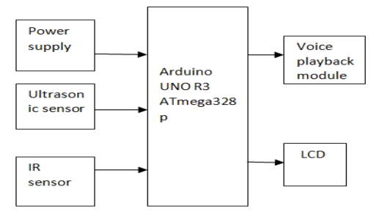
SYSTEM DESIGN
Fig.1 Voltage Regulator
Fig.2 Sensor related operations

Slide 9


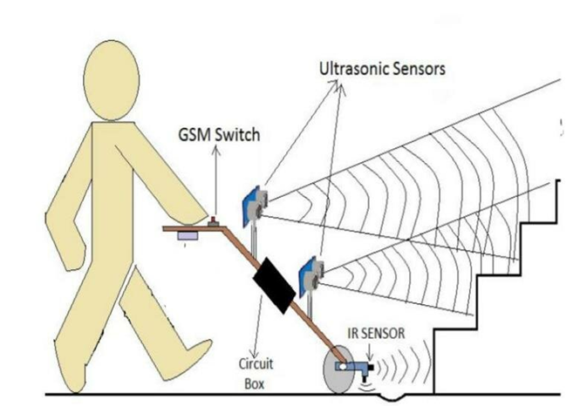
Ultrasonic
Sensor 2
SOS
switch
Ultrasonic
Sensor 1
Ultrasonic
Sensor 3
Height from ground=12cm
(All sensors inclined at 45 degrees angle with respect to ground)

Slide 10
CONCLUSION
This project is not just about introducing a new device; it is about embracing a vision where technology becomes a beacon of empowerment and inclusion. The road ahead involves refining and expanding our concept, seeking input from the very individuals we aim to assist, and continuously refining our design based on real-world feedback.

